Slide 1
Estimation of intrinsic camera parameters through single view geometry
Luca Del Pero
10SEP2010

Slide 2
Recap (1/2)
Our goal: recover intrinsic parameters from single images
Our approach: “undo” effects of the projective transformation caused by camera matrix
→ get intrinsic parameters for free
2D: Projective plane and transformations
A projective transformation:
loses parallelism and angles
“Undoing” a projective transformation means finding a transformation that
recovers parallelism and angles

Slide 3
Recap (2/2)
Recover parallelism: map back line at infinity
Recover angles: map back circular points

Slide 4
Agenda
Review of
hierarchy of transformations
line at infinity
circular points
3D extensions:
Plane at infinity
Absolute conic
Camera matrix and projective transformations
Find K from the image of the absolute conic
Application: K from 3 orthogonal vanishing points

Slide 5
Euclidean transformation: 3 DOF
Translations, rotations, reflections
Similarity transformation: 4 DOF
Loses lengths, areas
Affine transformation: 6 DOF
Loses length ratios, angles
Projective transformation: 8 DOF
Loses parallelism

Slide 6
Recovering parallelism (1/3)
Parallel lines intersect at
Points at infinity: (x1,x2,0)
Projective transformation move away (why?)
-> parallel lines will intersect not
at infinity anymore
Moving back means recovering parallelism
→ parallel lines will intersect at infinity again

Slide 7
Recovering parallelism (2/3)
is invariant to affinities
H is affinity iff does not move
Recipe to recover parallelism after
Affinities preserve parallelism
Find something invariant to affinities, ( )
Map it back to where it was with
Original and new are related by affinity →we got parallelism back
Preserves parallelism

Slide 8
Recovering parallelism (3/3)
Generic projective transformation
Lost parallelism
Recovered parallelism
Related by affinity
Puts back to its canonical position
Can we do the same for the angles???

Slide 9
Recovering angles
Recipe to recover angles after
Similarities preserve angles (projective do not)
Find something invariant to similarities
Map it back to where it was with
Original and new are related by similarity →we got angles back
Problems:
Why do similarities preserve angles?
Why affinities and projective do not?
What is the invariant?

Slide 10
Similarities preserve angles
Euclidean transformation with uniform scaling
Everything is scaled in the same way
Angles (and length ratios) are preserved

Slide 11
Affinities do not preserve angles
Example:
Apply to segment a =((0,0,1)-(0,1,1))
segment b=((0,0,1)-(1,0,1))
→they form a right angle
After transformation angle is no longer right
a’=((0,0,1)-(0,1,1)) b’=((0,0,1)-(1,1,0))

Slide 12
Recovering angles
Problems:
Why do similarities preserve angles?
OK
Why affinities and projective do not?
OK, affinities are a special case
of projective
What is the invariant to similarities?
Circular points

Slide 13
Circular points (1/4)
Points at infinity I= (1,i,0) J=(1,-i,0)
H is similarity iff it preserves I,J
If we map back circular points, new space and original space are related by a similarity. We can measure angles!

Slide 14
Circular points (2/4)
Absolute dual conic
Given two lines (l1,l2,l3), (m1,m2,m3), the angle between them
(Dp of normals)

Slide 15
Circular points (3/4)
This way of computing angles is invariant under
any projective transformation (Theorem 4)

Slide 16
Circular points (4/4)
If we know the circular points we can determine length ratios between segments (from angles and trigonometry)
Mapping the circular points back to the canonical position I,J is equivalent to getting rid of the projective distortion (up to a similarity)
Used for image rectification

Slide 17
Recovering angles
Generic projective transformation
Lost angles
Recovered angles
Related by similarity
Puts back circular points to canonical position

Slide 18
Summary so far
If we knew
Line at infinity
Circular points
we could undo a perspective transformation
In 2D
Circular points are enough (recover line at infinity from them)
Let’s now see how it works in 3D

Slide 19
3D: Plane at infinity (1/2)
Set of points
Two planes and two lines are parallel if they intersect at the plane at infinity
We can recover parallelism from knowing the plane at infinity

Slide 20
3D: Plane at infinity (2/2)
Direction of a line in 3D: (X1,X2,X3)
A line with dir (X1,X2,X3) intersects plane at infinity at (X1,X2,X3,0)
Lines with the same “direction” converge to a point on . How do we call them?

Slide 21
3D: Absolute conic (1/2)
A conic on
It lies on . Its matrix representation on it
is a 3X3 Identity.
A set of imaginary points. All spheres intersect it on the plane at infinity
Fixed under any similarity transformation

Slide 22
3D: Absolute conic (2/2)
Given two 3D lines with directions d1, d2
Intersection of d1, d2 with

Slide 23
Summary so far
If we knew
Plane at infinity
Absolute conic
We could undo a projective transformation in 3D and recover some properties (angles +
Parallelism)
How does this relate to cameras?????!

Slide 24
Image of the absolute conic
Projection of points on plane at infinity
Projection of the absolute conic (IAC)
It is on plane at infinity -> we can use H
The absolute conic is a 3X3 I on

Slide 25
What K gives us (1/4)
A 3D line direction d image point x back projects to
Ray in 3d
→ Scale does not matter

Slide 26
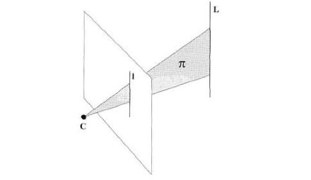
What K gives us (2/4)
A 3D plane an image line maps to
Plane normal

Slide 27
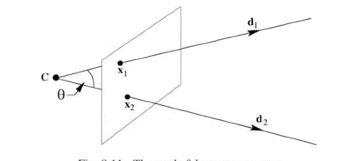
What K gives us (3/4)
Angles between rays d1, d2 corresponding to
image points x1,x2

Slide 28
What K gives us (4/4)
Finding K = finding IAC
→ we are able to backproject 2D entities
→ recover angles lost after projective transormation (what transformation is K?)
…. Still does not solve the dimensionality loss

Slide 29
Angles between rays with IAC

Slide 30
One last step
From IAC we can find K. How do we find IAC?
IAC is a conic -> 5 DOF. We need 5 constraints
Example
Skew = 0
Aspect ratio = 1
3 orthogonal vanishing points v1,v2,v3
(3 constraints)

Slide 31
Optional details
From Aspect ratio= 1 to constraint on IAC
IAC is a conic
AR=1 →
→

Slide 32
K from vanishing points
Given we know the position of three orthogonal vanishing points, we can find IAC
(under skew = 0, aspect ratio = 1) and thus K
We can solve this problem in Manhattan World (everything aligned with three main orthogonal directions)
We made it!

Slide 33
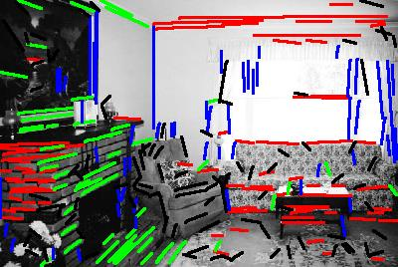
K from vanishing points
Detect line segments
Find 3 vanishing points with RANSAC
Use them to compute K

Slide 34
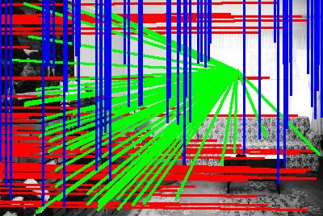
K from vanishing points

Slide 35
Vanishing points from IAC
We can use the IAC to find more accurate vanishing points
If our line segments are computed in a 2D coordinate system with origin = principal point
Discard vpts that return a non valid principal point
Also discard vpts giving f_length < 0

Slide 36
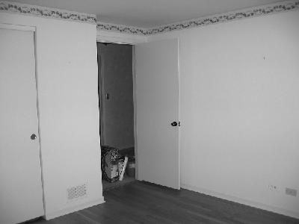
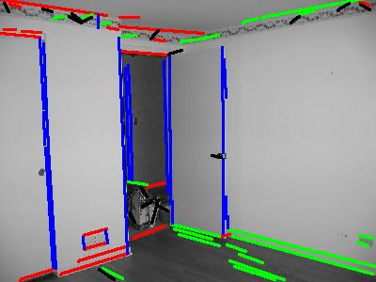
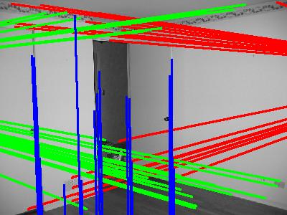
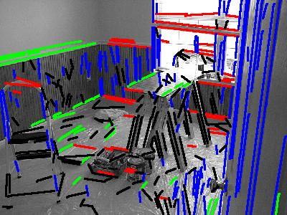
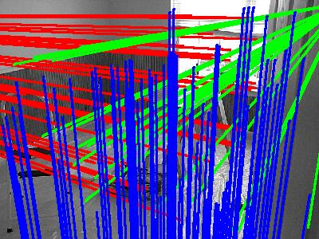
Vanishing points from IAC

Slide 37
QUESTIONS?

